Slide 1
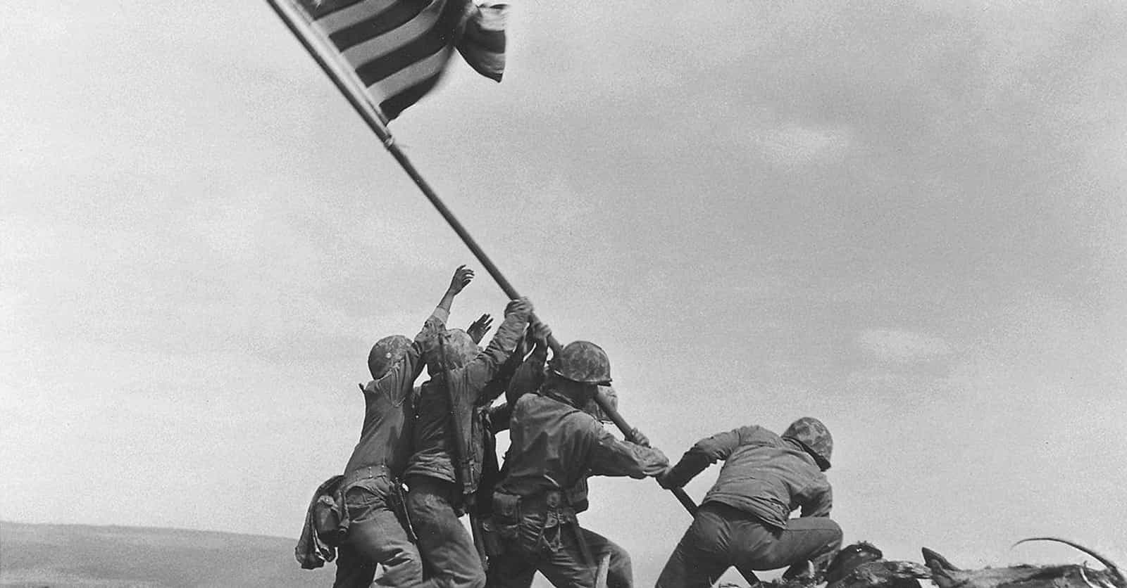
Fake History is not New

Slide 2
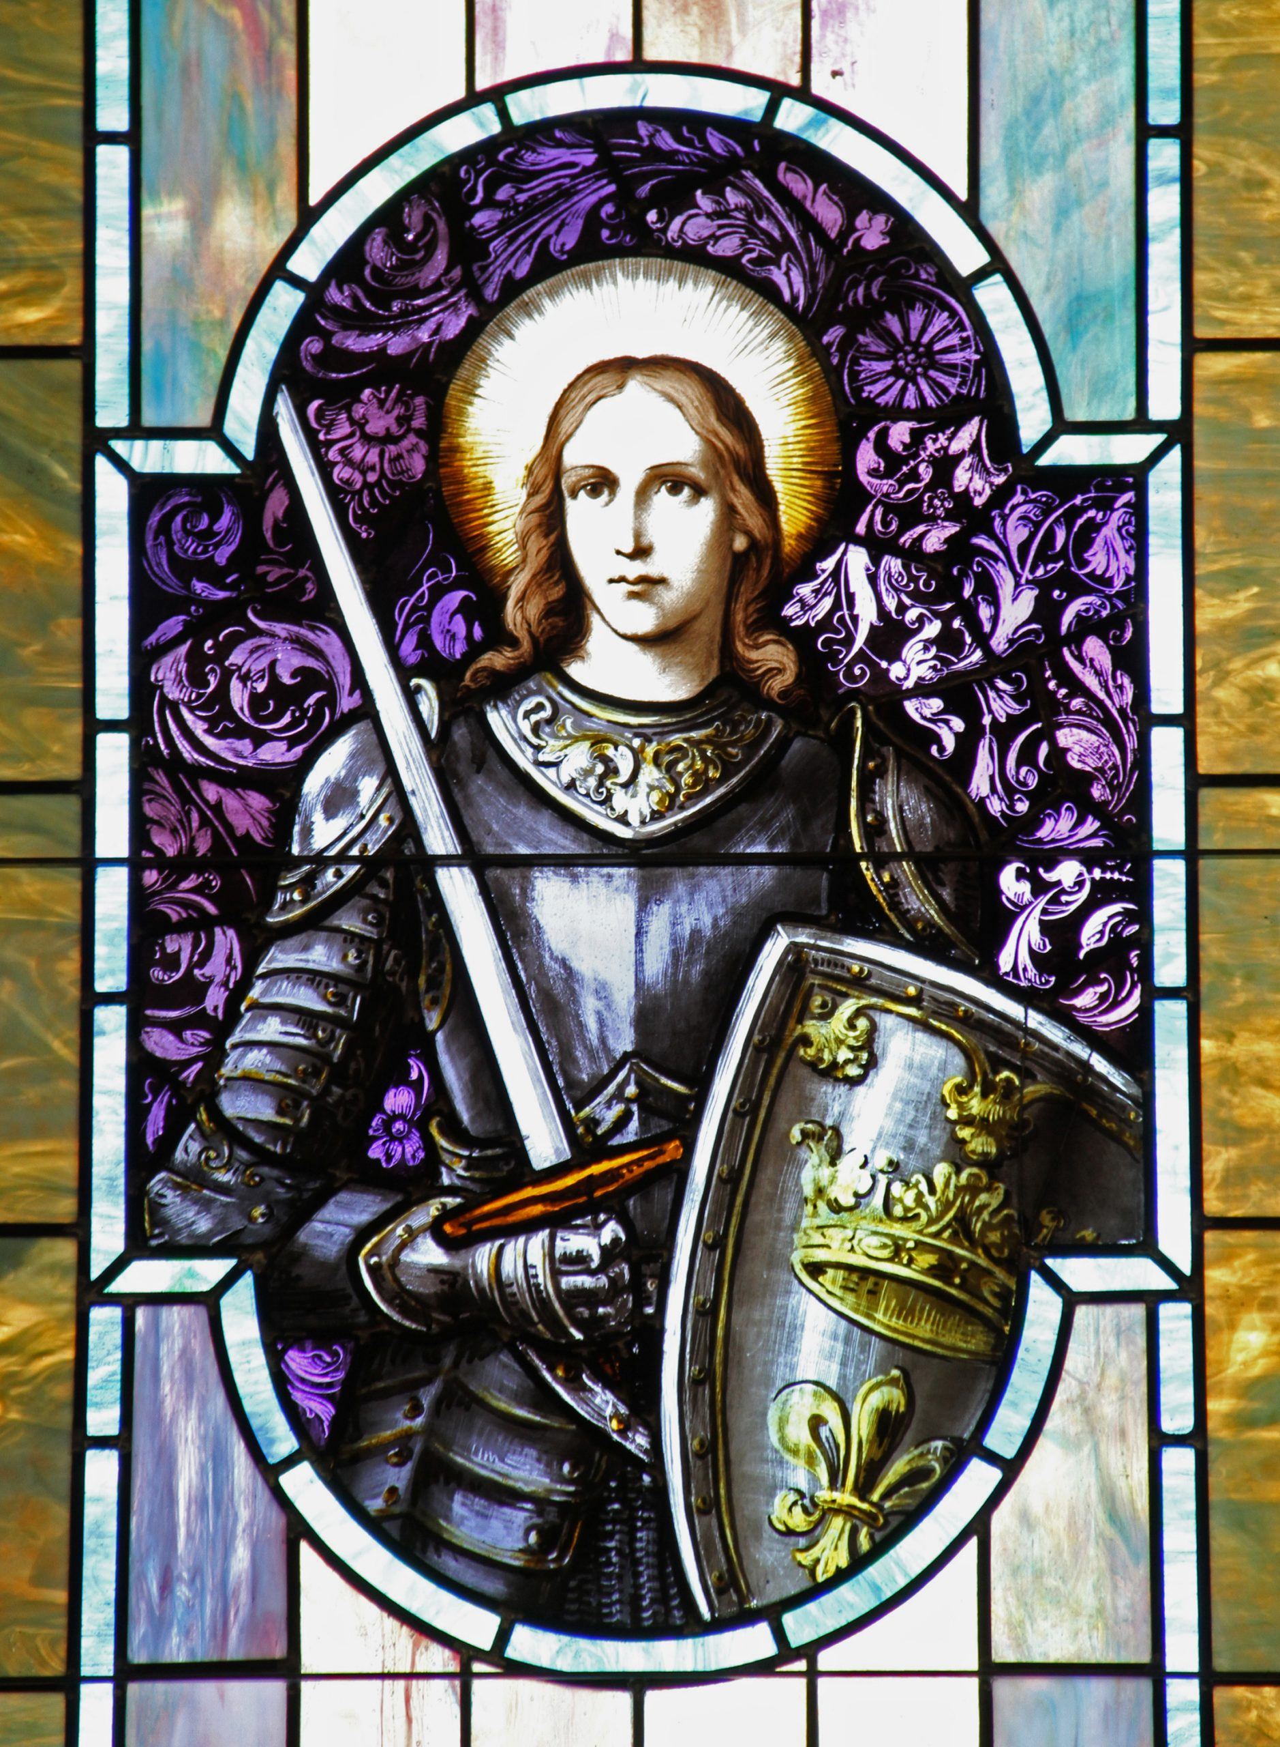
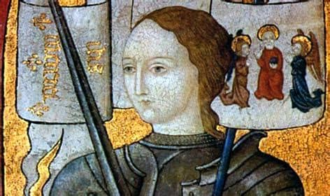
1-A Fake
Joan of Arc was born in an independent duchy in 1412. (There was no such place as Arc), She was created as a French hero in the nineteenth century when she was made the patron saint. She was executed for wearing men’s clothing, but it was by the Inquisition and the University of Paris not the English. There is no evidence that she fought in the hundred years war.

Slide 3
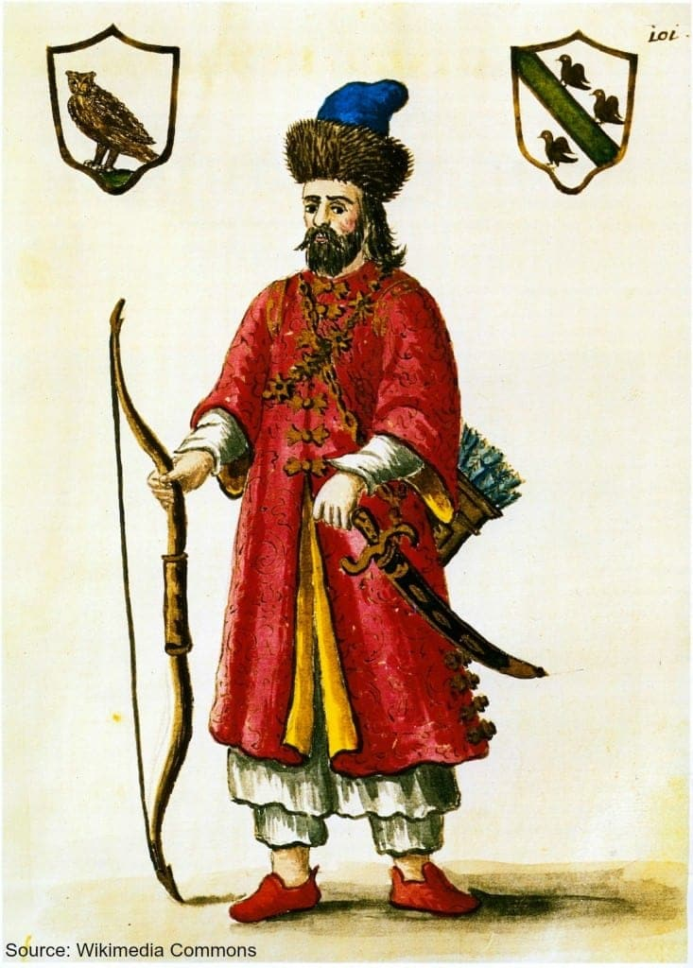
2-F Marco Polo fake
He claimed to have been the first European granted an audience with the court of Kublai Khan and was even given the governorship of Yangzhou for three years. All of this is unlikely, including that he never spoke any Chinese language after a supposed 17 years there. There was documented pasta in Italy long before he was born.

Slide 4
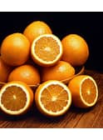
3-Q True
The fruit came first and was the source of the word for the color. Most languages don’t have a special word for Yellow-Red. The earliest recorded use of the word in English dates to the 13th century and refers to the fruit. The first recorded use of "orange" as a color name in English was in 1502.

Slide 5
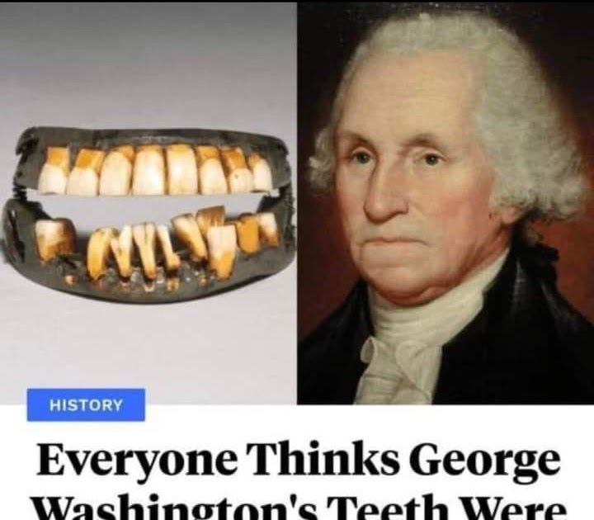
4-E true
His false teeth were not wooden. Instead, his dentures were crafted from a variety of materials, including human teeth (often obtained from slaves), animal teeth, ivory, and metal.

Slide 6
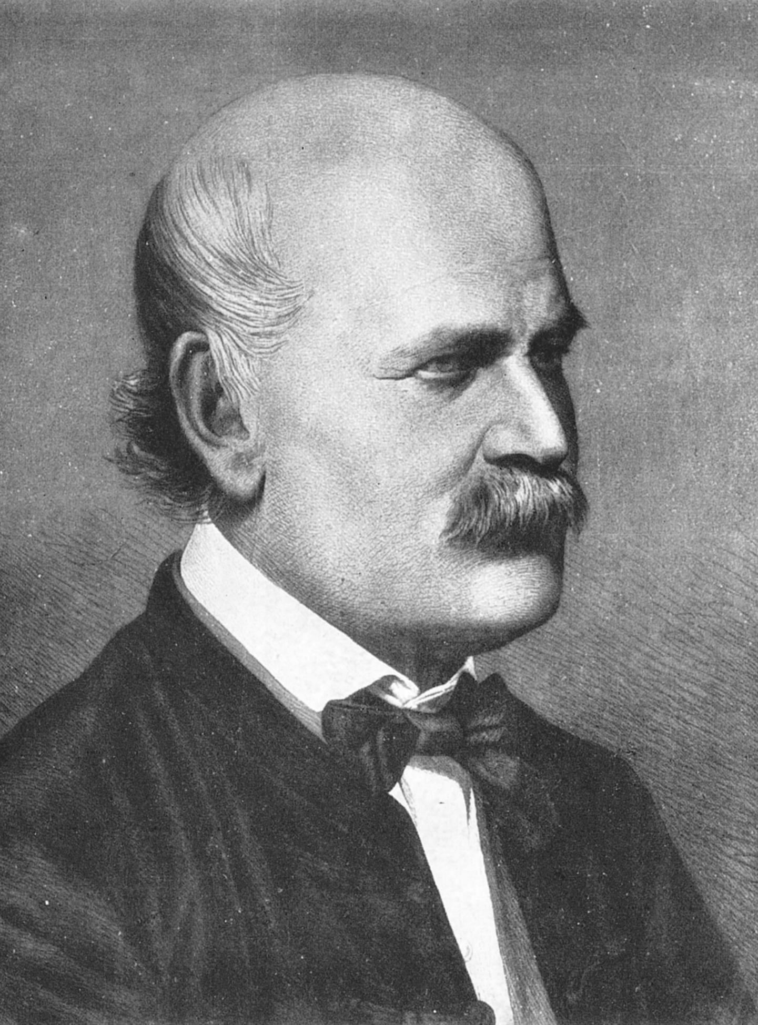
5-D True
Despite his research, Semmelweis's observations conflicted with the established scientific and medical opinions of the time, and his ideas were rejected by the medical community. He could offer no theoretical explanation for his findings of reduced mortality due to hand-washing, and some doctors were offended at the suggestion that they should wash their hands and mocked him for it. His findings were widely accepted only years after his death, when Louis Pasteur confirmed the germ theory, providing a theoretical explanation for Semmelweis's observations, and Joseph Lister, building on Pasteur's research, practiced and promoted hygienic methods with great success.

Slide 7

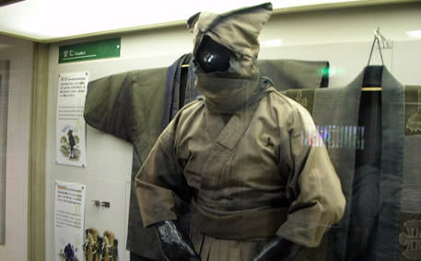
6-G Fake
Ninja were a group that mainly conducted covert operations for a feudal lord. Their position was different from that of samurai or ashigaru (common foot soldiers). A figure in a black costume can be seen at night; thus, it is considered that their costume was dark blue or a persimmon color.
Female ninja are generally called "Kunoichi" (the origin of this code name is the Japanese character "女," meaning "woman," and, according to the myth, they would be easy to identify when dressed).

Slide 8
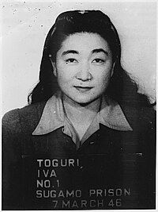
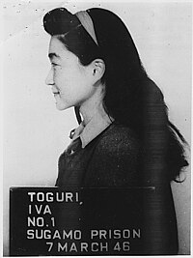
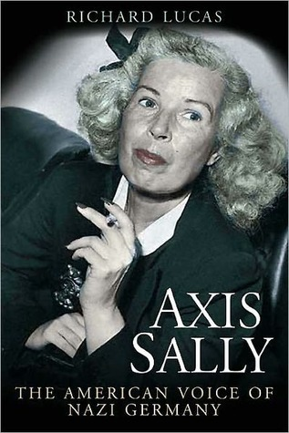
7-L True
Tokyo Rose ceased to be merely a symbol during September 1945 when Iva Toguri D'Aquino, a Japanese-American disc jockey for a propagandist radio program, attempted to return to the United States.[1] Toguri was accused of being the "real" Tokyo Rose, arrested, tried, and became the seventh person in U.S. history to be convicted of treason. Toguri was eventually paroled from prison in 1956, but it was more than twenty years later that she received an official presidential pardon for her role in the war.
Mildred Gillars,(known as Axis Sally) a German-American who broadcast for Germany.] She was "the first woman in US history to be convicted of treason" by the United States, and following her arrest in Berlin, on 8 March 1949, she was sentenced to ten to thirty years' imprisonment."^{[3]}

Slide 9
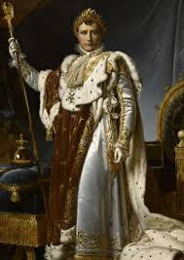
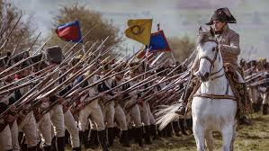
8-K Fake
Despite popular belief, Napoleon Bonaparte was not actually short. He was around 5 feet 6 inches tall, which was average height for the time. His nickname, "The Little Corporal," was more of a term of endearment than a reference to his height.

Slide 10
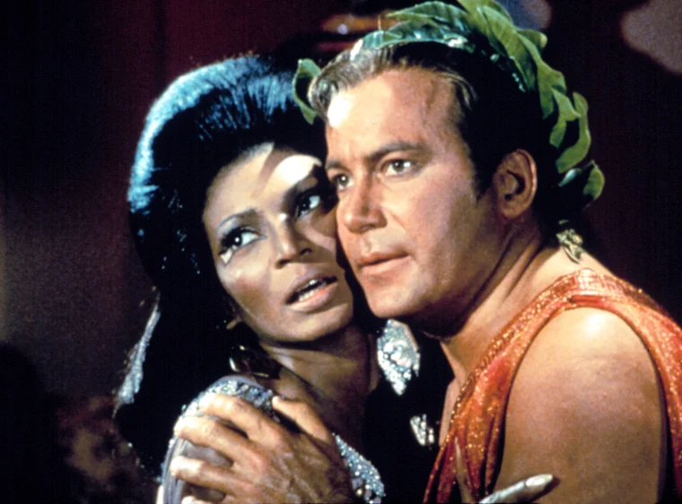
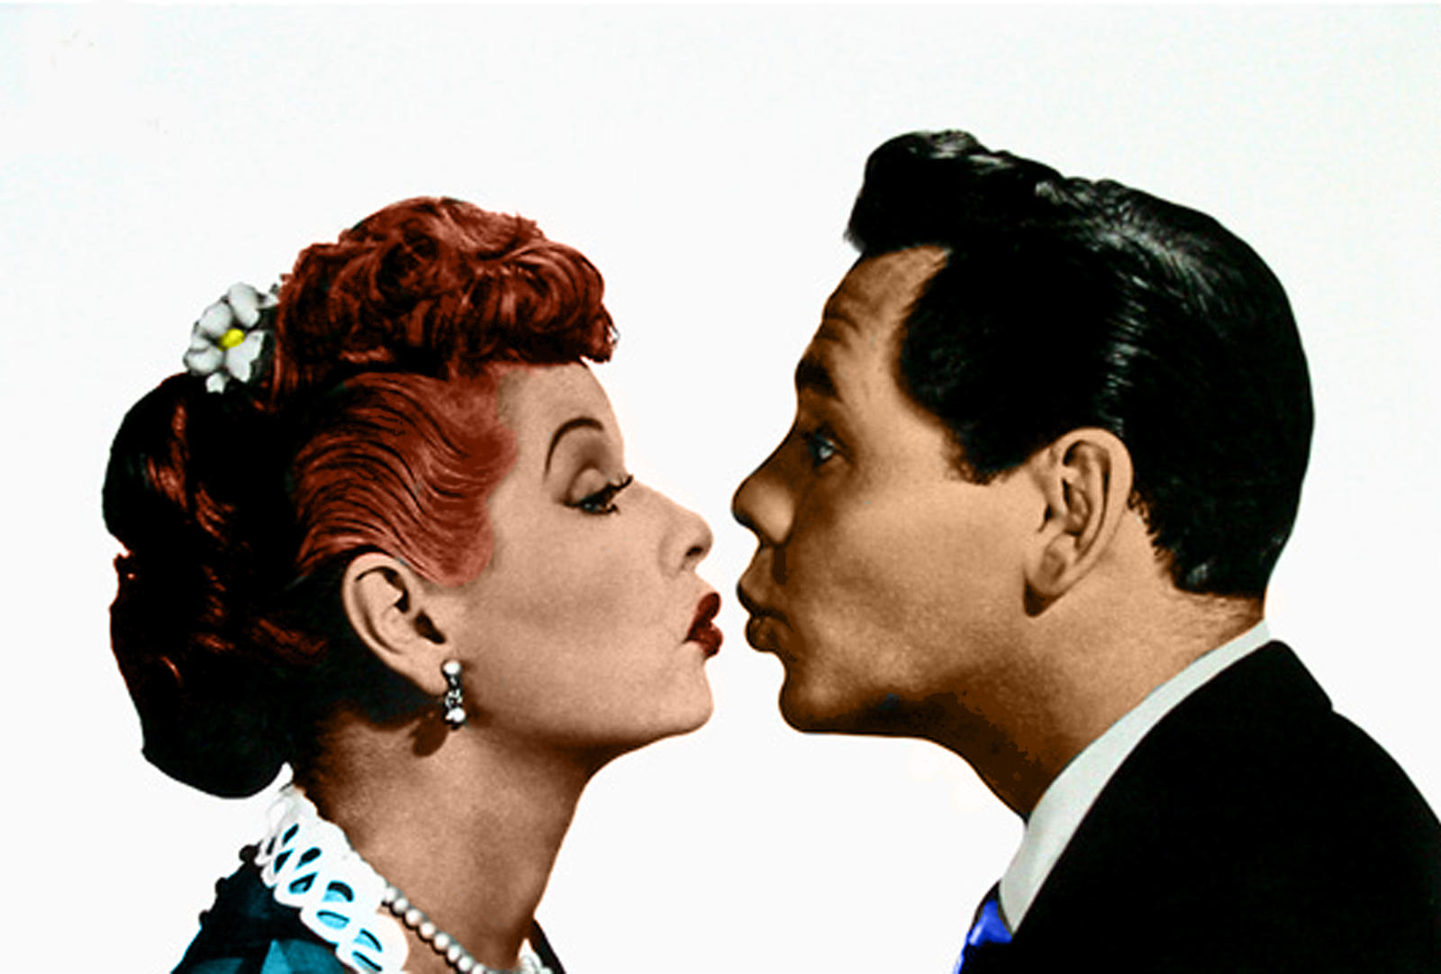
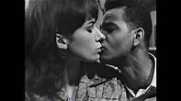
9-M
    FakeThe iconic kiss between Captain James T. Kirk and Lieutenant Nyota Uhura in “Star Trek The Original Series” is often hailed as the first interracial kiss shown on television. However, this claim isn’t entirely accurate.
Ricky and Lucy (1950s): The true pioneers were Ricky and Lucy from the beloved show “I Love Lucy.” Lucille Ball (who played Lucy) and Desi Arnaz (who played Ricky) shared several kisses on-screen. Although Arnaz was Cuban-American, he was considered white-passing, so their kisses weren’t widely perceived as interracial by the public.
“Sea Hunt” (1959): In an episode titled “Proof of Guilt,” Japanese-Canadian actress Nobu McCarthy kissed the main character, Mike, played by Lloyd Bridges. Despite this milestone, it didn’t receive the same historical significance as Kirk and Uhura’s kiss.
Six years before Capt. Kirk and Lt. Uhura locked lips on “Star Trek” in what is often credited as TV’s first interracial kiss; another couple was pushing boundaries
Newly uncovered footage from the British Film Institute (BFI) shows a black man and a white woman kissing in a televised play of “You in Your Small Corner,” in 1962.
In the 1960s Britain, such displays of affection were unheard of on the small screen, and the institute believes this is not just the earliest interracial kiss on British TV, but possibly the world.

Slide 11
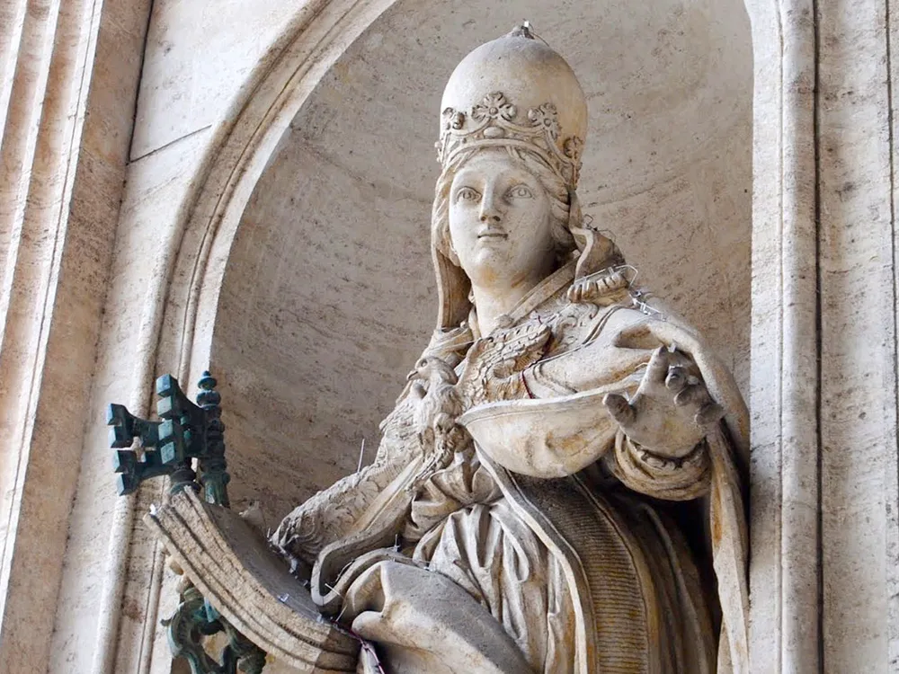
10-N Fake
In the late Middle Ages, a popular legend advanced the story of a medieval woman who disguised herself in men’s clothing and ascended to the role of pope.
A dramatic ending to the tale ensured its endurance: As the woman, masquerading as Pope Johannes Anglicus, led a religious procession through Rome during the mid-ninth century, she allegedly went into labor, exposing the fact that “Johannes” was actually “Joan.”
While most historians believe Pope Joan is nothing more than a myth invented by early critics of the Catholic Church, her story has proven too tantalizing to be forgotten.
According to a British Library blog post written after Rihanna donned papal mitre for the 2018 Met Gala, the first direct mention of Joan appears some 300 years after the female pope was claimed to have lived—a lapse in time that Jensen cites as “the ultimate red flag.”

Slide 12
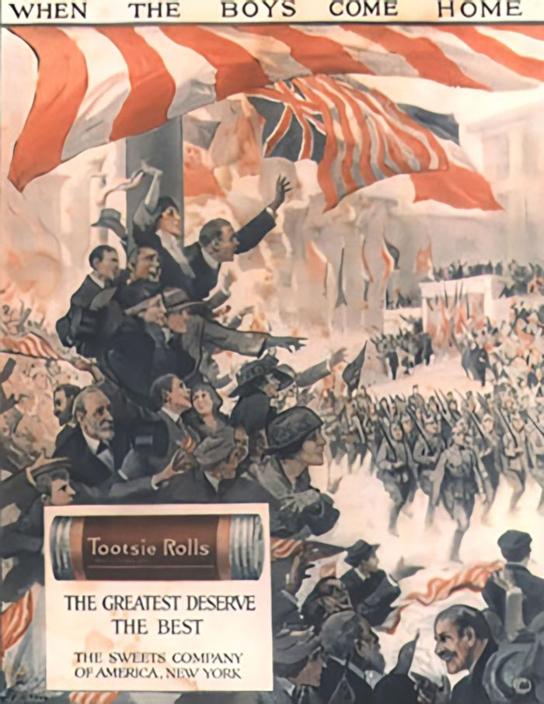
11-J True
During the brutal Battle of Chosin Reservoir in the Korean War, a group of surrounded U.S. Marines made an urgent radio call for a resupply of 60mm mortar rounds, using their codename for the ammunition: "Tootsie Rolls." Due to a communication mix-up, the next airdrop they received wasn't ammunition, but thousands of actual Tootsie Roll candies. While initially a frustrating mistake, the candy proved to be a lifesaver. It was one of the few rations that didn't freeze solid in the sub-zero temperatures, providing much-needed calories. More importantly, the Marines discovered that when they chewed the Tootsie Rolls into a malleable putty, it was perfect for patching bullet holes and cracks in their vehicles' fuel lines, hoses, and radiators. This makeshift, edible patch kit proved surprisingly effective, allowing them to keep their equipment running and aiding in their eventual breakout.

Slide 13
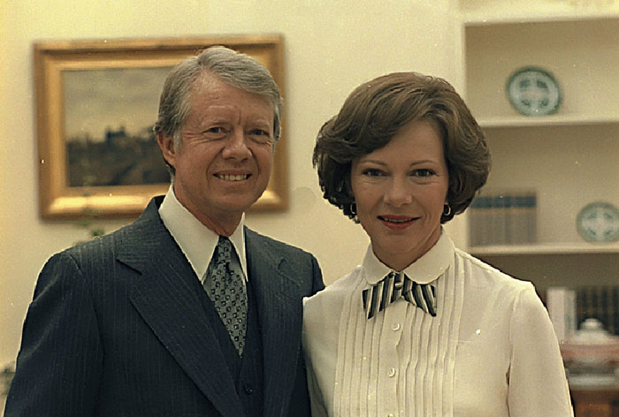
12-K True
The bond between Jimmy and Rosalynn Carter began decades before they ever fell in love, right at the moment of her birth. In the small town of Plains, Georgia, Jimmy's mother, Lillian Carter, was a registered nurse who assisted in delivering her neighbor's new baby, Rosalynn Smith. According to the story, a three-year-old Jimmy was the first person his mother told about the newborn girl. This remarkable small-town connection served as the unknowing first chapter to what would become the longest presidential marriage in American history, linking the future president and first lady from Rosalynn's very first da

Slide 14
END

Slide 15
These were the ones that were fake news. The others are true.
B- Vikings typically wore horned helmets. This was a later affection from the stage. There is no evidence that they actually did that.
C- Marie Antoinette said, “Let them eat cake,” when told the people had no bread There is no contemporary evidence that she said this. They sought to discredit her.
H- The Pyramids in Egypt were built by slaves, including the Hebrews. Passover notwithstanding, there is no evidence that the Hebrews were ever in Egypt, and there is substantial evidence that the workers on the pyramids were well paid and cared for, not treated as slaves.
I- The Tudors (and medieval Europeans) used spices to mask the taste of spoiled meat. Spices had to be imported at great cost. The wealthy who could afford meat didn’t need to eat it spoiled.
J-During Roman feasts, guests would leave to vomit in the vomitorium in order to empty their stomachs and make it possible to eat more food. The vomitorium comes from the Latin for disgorging which is why the confusion happens. It was a place for the people to leave after the event.
O. The monster in Mary Shelly’s book is named Frankenstein. Frankenstein is the scientist, not the creation. It is just called the monster.
P- Cleopatra committed suicide by getting a servant to bring her a basket of figs with a poisonous asp in it. She died when the snake bit her. She did commit suicide, but not with an asp- it would have taken much too long. This was also probably a fake story to discredit her because figs were a sign of sexuality at that time.

