Slide 1
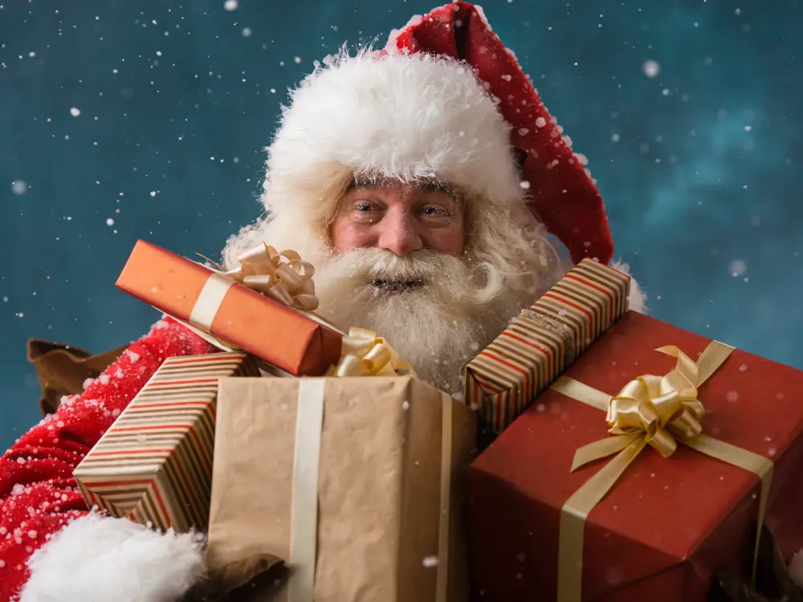
Santa Claus Around the World
Answers
Reference:
https://www.businessinsider.com/santa-claus-around-the-world-2017-12#united-kingdom-father-christmas-1

Slide 2
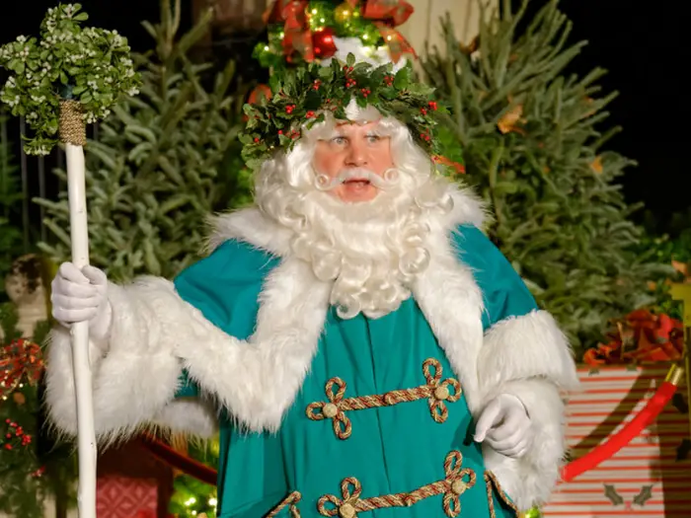
A- United Kingdom — Father Christmas
Certain traditions are just a natural part of the British Christmas: Yorkshire pudding and turkey on the Christmas table, kids pulling Christmas crackers, and Father Christmas wearing green.
Although you will see the more popular, red-suited version of Santa on Christmas in the UK, the traditional British Father Christmas wears a hooded green cloak, a wreath of holly or ivy, and carries a staff. His appearance — like many Christmas traditions — is rooted in pagan mythology.

Slide 3
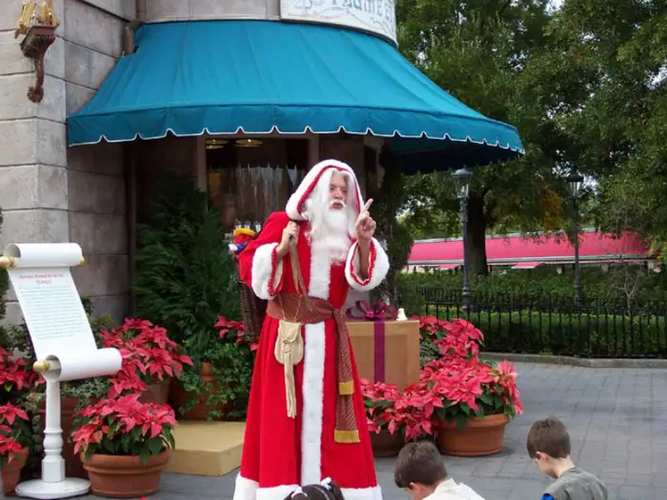
2-B
France — Père Noël or Papa Noël
While his name may just be French for Father Christmas, Père Noël has his own Christmas traditions.
He wears a long red cloak instead of a red suit, and children leave their shoes by the fireplace hoping that they will be filled with goodies after mass on Christmas Eve.
Père Noël also traditionally travels with a not-so friendly companion called Père Fouettard, or "the whipping father," who spanks any children who have not behaved well throughout the year.

Slide 4
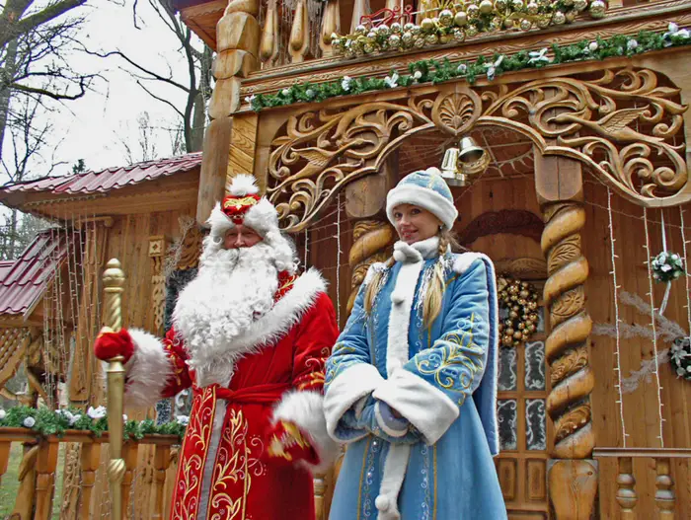
3- C Russia and Ukraine — Ded Moroz and Snegurochka (Father Frost and Snow Maiden)
Ded Moroz (translated as Father Frost) is a figure of Slavic mythology, often depicted as a wizard or demon. Traditionally, he would punish naughty children by kidnapping them, but this darker part of Ded Moroz's personality has softened over the years.
Now, on New Year's Eve, he travels all over the Slavic region, mainly in Russia and Ukraine, carrying gifts for children with his cheerful companion, Snegurochka the Snow Maiden.

Slide 5
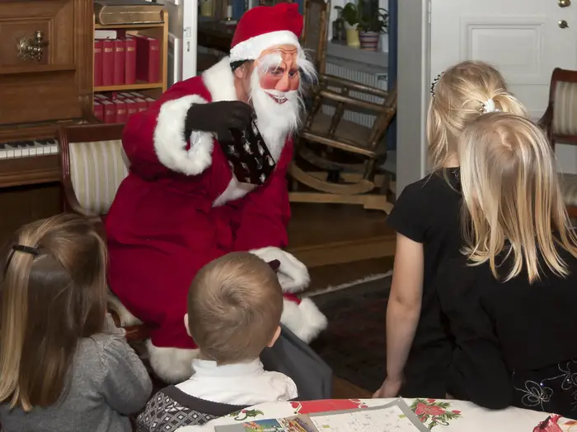
4-D Sweden — Tomte or Jultomten
Tomte or Jultomten is a creature based in Swedish folklore. Traditionally a dwarf-like being with the appearance of a garden gnome, the tomte guards farmhouses from bad luck. Although he was originally associated with the devil, the tomte legend has in modern times become conflated with Santa Claus.
On Christmas, an adult family member will dress up as Jultomten — complete with a face mask as seen above — and ask "are there any good children who live here?" before distributing his sack of presents.

Slide 6
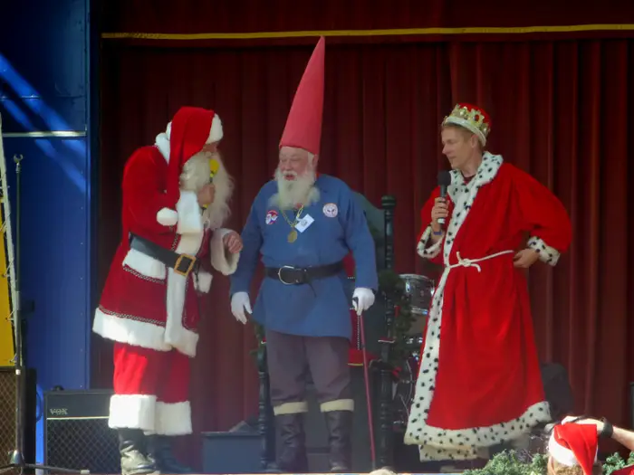
5- E. Norway — Julenissen
The Nissen or Julenissen in Norwegian folklore are very similar to the Swedish Jultomten. Known as Christmas pixies or Christmas elves, the Julenissen were traditionally barn devils who would act as spirit guardians over farms.
Nowadays, Julenisse comes from the North Pole and give gifts to little children on Christmas, just like the iconic version of Santa Claus. Unlike Santa, Julenisse wears grey clothes and usually has a grey beard instead of a white one.

Slide 7
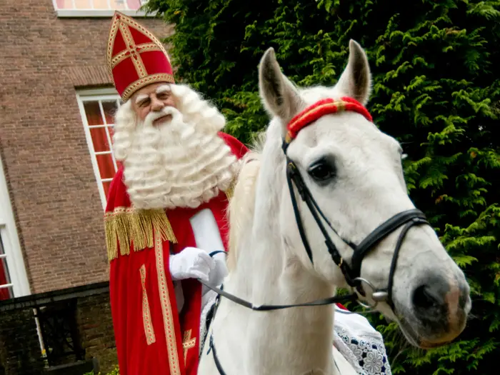
6- F The Netherlands — Sinterklaas
Sinterklaas is the Dutch version of Santa Claus who most resembles St. Nicholas, the patron saint of children and inspiration for the modern Santa Claus legend.
Sinterklaas comes riding into town on a white horse, wearing a tall, red bishop's hat and a jeweled staff. He knocks on doors and brings gifts to good children, while his companion, Grumpus, rattles chains at naughty children and threatens to kidnap them.

Slide 8
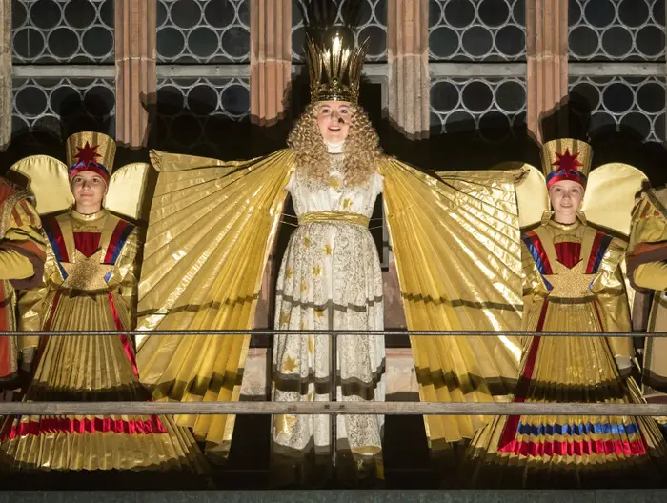
7- G -Austria, Switzerland, and Germany — Christkind or Christkindl
Christkind or "Christ Child" is the benevolent (usually female) gift-bringer who leaves presents for good children on Christmas Eve, much like her more famous counterpart, Santa Claus. She makes appearances to Lutheran families in Germany, Austria, Czech Republic, and the Slovakian region, and usually appears wearing a crown and long, curly blonde hair.
Christkind's angelic appearance and peaceful persona is derived from baby Jesus Christ himself, and comes from the Protestant tradition that Jesus — instead of a mythological creature like Santa or Father Frost — leaves behind presents on Christmas year, the city of Nuremberg in Germany chooses a child to play the part of the Christkind during the holiday market and celebration known as Christkindlmarkt.

Slide 9
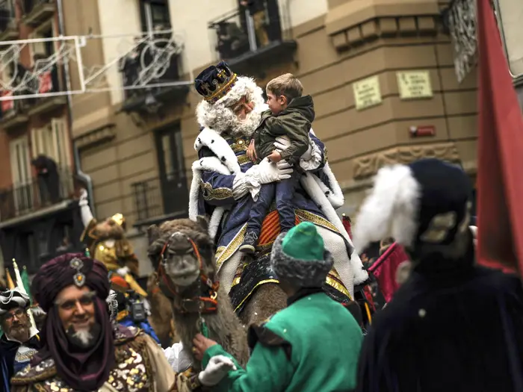
8-H. Spain — Los Reyes Magos
In Spain, good children are not only visited by one, but three jolly figures who disseminate presents on El Dia De Reyes, the day that the three wise men (or magi) finally reached baby Jesus on January 6.
In the days leading up to El Dia de Reyes, children in Spain, Mexico, and other Hispanic countries will write letters to their favorite mago — Melchor, Gaspar, or Baltasar — asking for gifts.
That night, children leave out sweets for the magi and hay for the camels they ride on (sound familiar?), and place their shoes where the magi will spot them. The next day, the offerings will be replaced by presents.

Slide 10
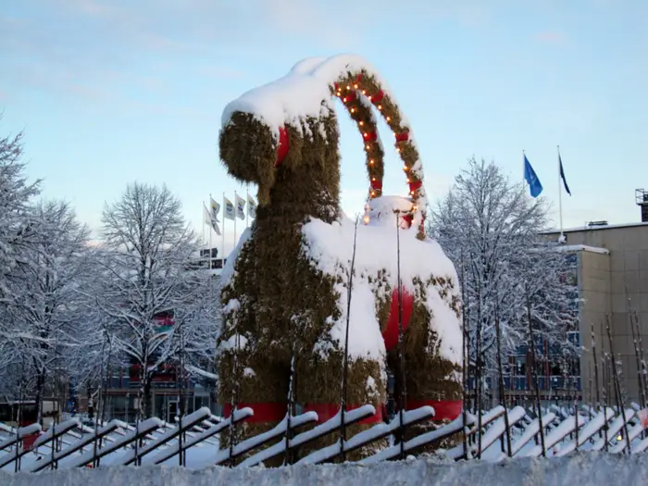
9- I. Finland — Joulupukki or Yule goat
Joulupukki, also known as the Yule goat, has been nicknamed the Finnish Santa. Before globalism naturally combined traditional Scandinavian customs with modern-day Santa Claus, the Yule goat was a malevolent spirit associated with the Norse god Odin who knocked on doors and demanded gifts and leftovers from the Yuletide feasts.
Nowadays, Joulupukki still goes around to each house, but will instead inquire, "Onko täällä kilttejä lapsia?” (“Are there any well-behaved children here?”) and hand out presents. He drives a sleigh pulled by reindeer that does not actually fly.
Modern decorative representations of the Yule goat are usually made out of straw, like the famous Gävlebocken in Gavle, Sweden, which has been set on fire 26 times out of 47 years, and has become a somewhat macabre pyrotechnic tradition.

Slide 11
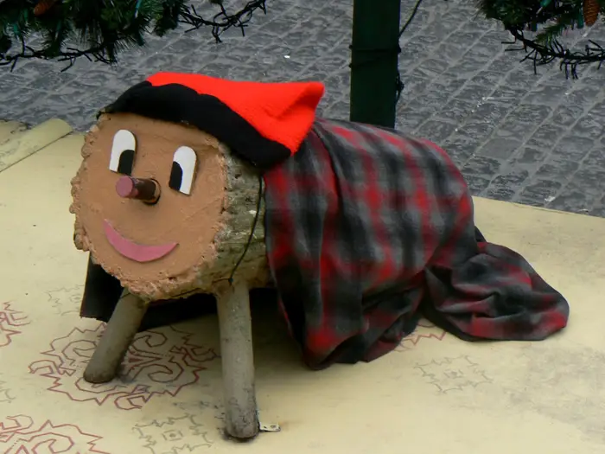
10- J. Catalonia — Tió de Nadal
As perhaps the most fun-loving tradition on this list, Tió de Nadal is a log with a painted-on smiley face who defecates presents (yes, really!).
In the Catalonian region of Spain, children place Tió de Nadal under the Christmas tree and "feed him" nuts and dried fruit in the days leading up to Christmas, while simultaneously keeping him warm under a blanket.
On Christmas Eve, the children beat poor Tió with sticks and sing a rather graphic song about bodily functions. The next morning, the children will find that Tió de Nadal has defecated a pile of gifts and sweets.

Slide 12
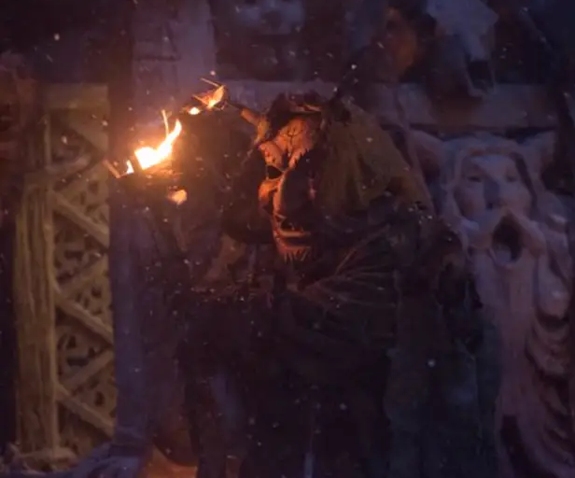
11- K. Iceland — Yule Lads
The Yule Lads are 13 mischievous Icelandic elves — who instead of making toys in Santa's workshop — play tricks on children. Pottasleiki for instance, will steal your leftovers, while Gryla — the mother of the 13 Yule Lads — will kidnap you if you have behaved badly.
During the 13 nights leading up to Christmas, Icelandic children place their shoes by the windowsill in the hopes that one of the 13 Yule Lads will leave them small gifts or candies. Misbehaved children will instead receive rotten potatoes in their shoes.

Slide 13
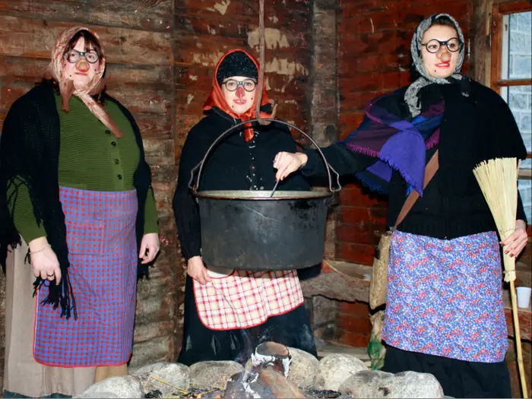
12- Italy — La Befana
Long before the man in the red suit was bringing toys to children on Christmas, La Befana — a good-natured witch who flies around on a broomstick — was doing the same for good children in Italy. She has been a part of Italian folklore since the 8th century.
According to the story, the three wise men came upon La Befana's house on Christmas Eve when they were journeying to see baby Jesus. She gave the wise men shelter and they asked her to join them to visit the Christ child. She declined, but then later changed her mind and tried to catch up with the magi.
However, she never found her way to Bethlehem, and now every night on the Eve of the Epiphany on January 5, she flies over Italy and gives toys and candy to good children, while leaving coal for the naughty ones.

Slide 14
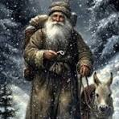
13- M. Olentzero- Basque Country
Olentzero is a mythical figure of Basque Christmas tradition which is believed to visit towns during Christmas Eve (December 24th) to give gifts to local children. The tradition involving the Olentzero originated in the 17th century in Basque Country.

Slide 15
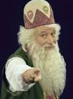
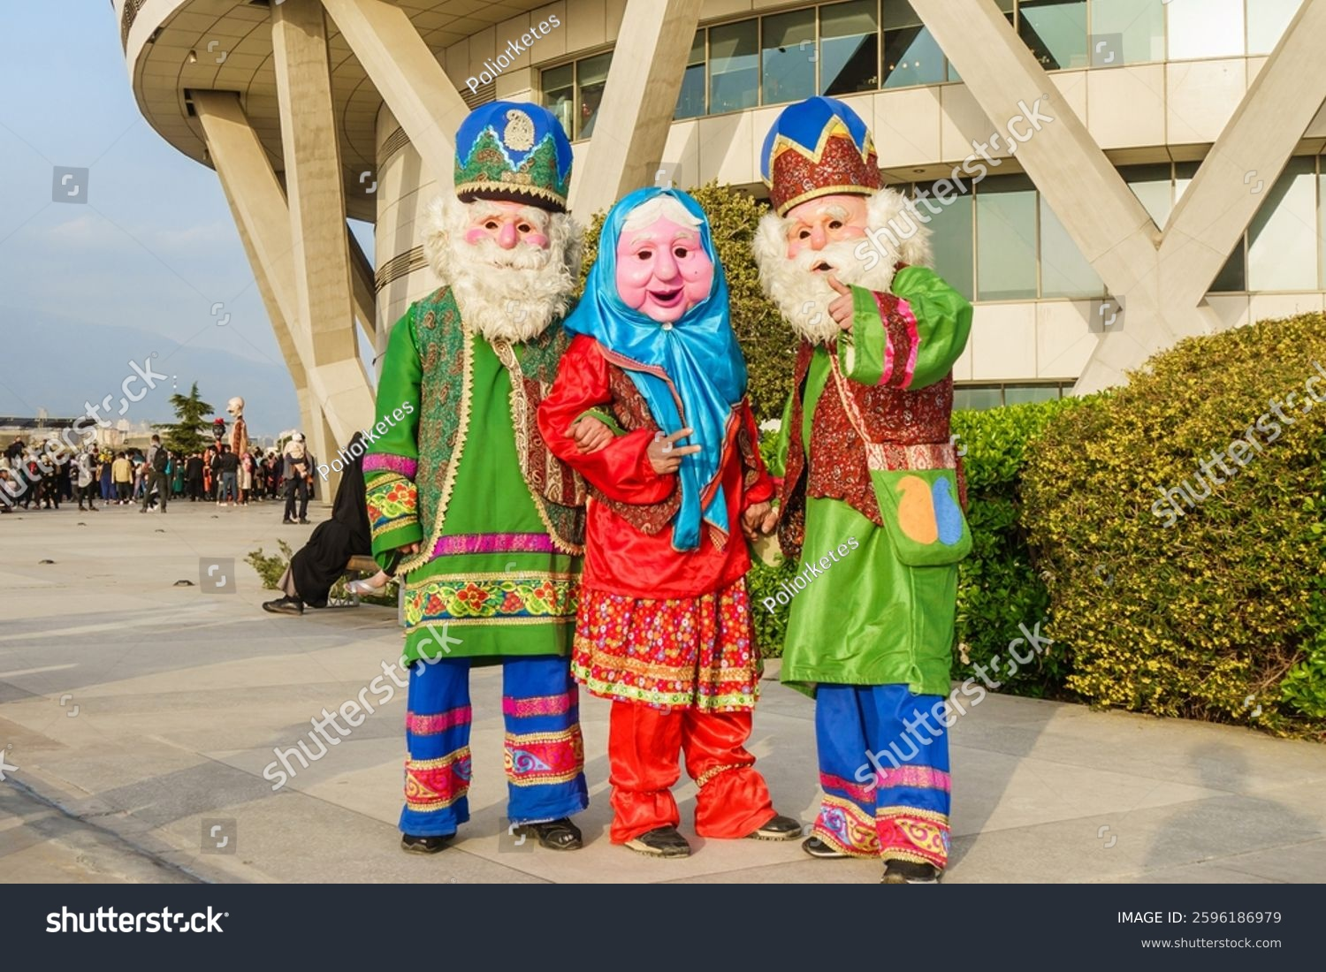
14- N. Iran- Amu Nowruz
Amu Nowruz is an Iranian fictional figure featuring in local folklore. Also known as Papa Nowruz, Amu Nowruz is believed to appear at the start of spring of each year accompanied by Haji Firuz, another fictional figure, to commemorate the opening of the Iranian New Year, Nowruz. Similar to Santa Claus, Amu Nowruz is depicted as a silver-haired old man, spotting long white beards, who visits children and gives them gifts. In contrast, Haji Firuz, Amu’s companion, plays tambourine and demands gifts from children.
4. Russian - Ded Moroz

